Slide 1

K-12 Microelectronic Workshop Arduino Programming
1 struct instructor {
2 String name = “Yi Liu”;
3 String department = “Mechanical Engineering”;
4 String university = “University of Vermont”;
5 }

Slide 2
Contents
1. Introduction
1.1 What is Arduino
1.2 Embedded system
1.3 Hardware — Arduino board components
1.4 Software — Arduino IDE
1.5 Summary

Slide 3
Contents
2. First Arduino Program
2.1 Arduino sketch structure
2.2 Uploading
2.3 Using delay — a blinking LED
2.4 Debugging with Serial
2.5 Summary

Slide 4
Contents
3. Arduino Basic Programming and Interfacing
3.1 Using if — control an LED
3.2 Using for — a breathing LED
3.3 Summary

Slide 5
Contents
4. Sensors
4.1 HC-SR04 ultrasonic sensor
4.2 DHT22 temperature and humidity sensor
4.3 Summary

Slide 6
Contents
1. Introduction
1.1 What is Arduino
1.2 Embedded system
1.3 Hardware — Arduino board components
1.4 Software — Arduino IDE
1.5 Summary

Slide 7
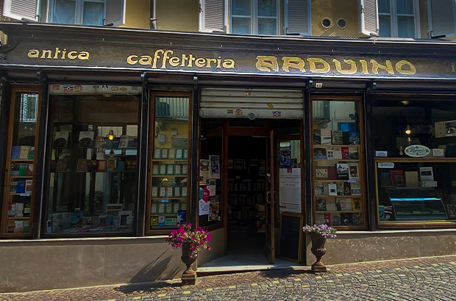
1.1 What is Arduino
created in 2005, Ivera, Italy
named after a bar

Slide 8
1.1 What is Arduino
open-source electronics platform

Slide 9
1.1 What is Arduino
open-source electronics platform
consists hardware and software

Slide 10
1.1 What is Arduino
open-source electronics platform
consists hardware and software
uses C++

Slide 11
1.1 What is Arduino
open-source electronics platform
consists hardware and software
uses C++
reads sensors

Slide 12
1.1 What is Arduino
open-source electronics platform
consists hardware and software
uses C++
reads sensors
processes data

Slide 13
1.1 What is Arduino
open-source electronics platform
consists hardware and software
uses C++
reads sensors
processes data
controls outputs

Slide 14
1.1 What is Arduino
open-source electronics platform
consists hardware and software
uses C++
reads sensors
processes data
controls outputs
embedded development platform

Slide 15
Contents
1. Introduction
1.1 What is Arduino
1.2 Embedded system
1.3 Hardware — Arduino board components
1.4 Software — Arduino IDE
1.5 Summary

Slide 16

1.2 Embedded system
Purpose
designed for specific task
washing machine
car’s braking system
pacemaker

Slide 17

1.2 Embedded system
Purpose
designed for specific task
washing machine
car’s braking system
pacemaker
User interaction
works in the background
little or no direct user control

Slide 18

1.2 Embedded system
Power consumption
optimized for low power use
for energy-critical applications

Slide 19

1.2 Embedded system
Power consumption
optimized for low power use
for energy-critical applications
Software
runs Real-Time Operating System
limited or no updates

Slide 20

1.2 Embedded system
Power consumption
optimized for low power use
for energy-critical applications
Software
runs Real-Time Operating System
limited or no updates
Hardware
low-power microcontroller
minimal memory

Slide 21
Contents
1. Introduction
1.1 What is Arduino
1.2 Embedded system
1.3 Hardware — Arduino board components
1.4 Software — Arduino IDE
1.5 Summary

Slide 22
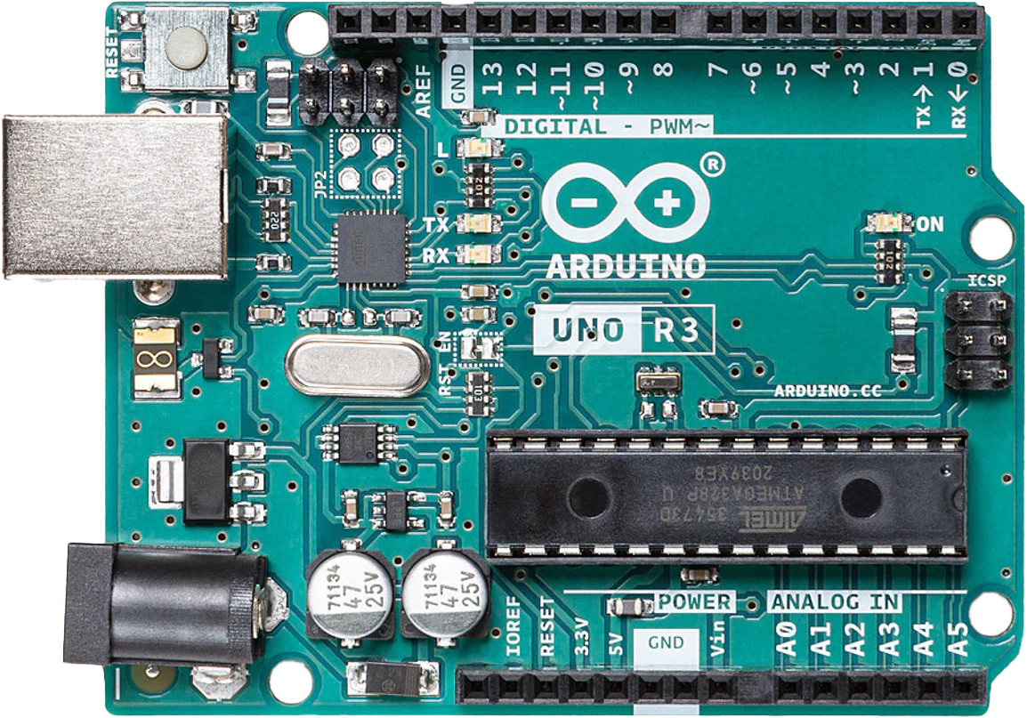
1.3 Hardware — Arduino board components

Slide 23
1.3 Hardware — Arduino board components
USB Connector
Microcontroller
DC Barrel Jack

Slide 24
1.3 Hardware — Arduino board components
USB Connector
Crystal Oscillator
Microcontroller
DC Barrel Jack

Slide 25
1.3 Hardware — Arduino board components
Digital I/O
USB Connector
Crystal Oscillator
Microcontroller
DC Barrel Jack
Analog Inputs

Slide 26
1.3 Hardware — Arduino board components
Digital I/O
Inbuilt LED
USB Connector
Power LED
TX & RX LED
Crystal Oscillator
Microcontroller
DC Barrel Jack
Analog Inputs

Slide 27
1.3 Hardware — Arduino board components
Digital I/O
Reset Button
Inbuilt LED
USB Connector
Power LED
TX & RX LED
Crystal Oscillator
Microcontroller
DC Barrel Jack
Analog Inputs

Slide 28
Contents
1. Introduction
1.1 What is Arduino
1.2 Embedded system
1.3 Hardware — Arduino board components
1.4 Software — Arduino IDE
1.5 Summary

Slide 29
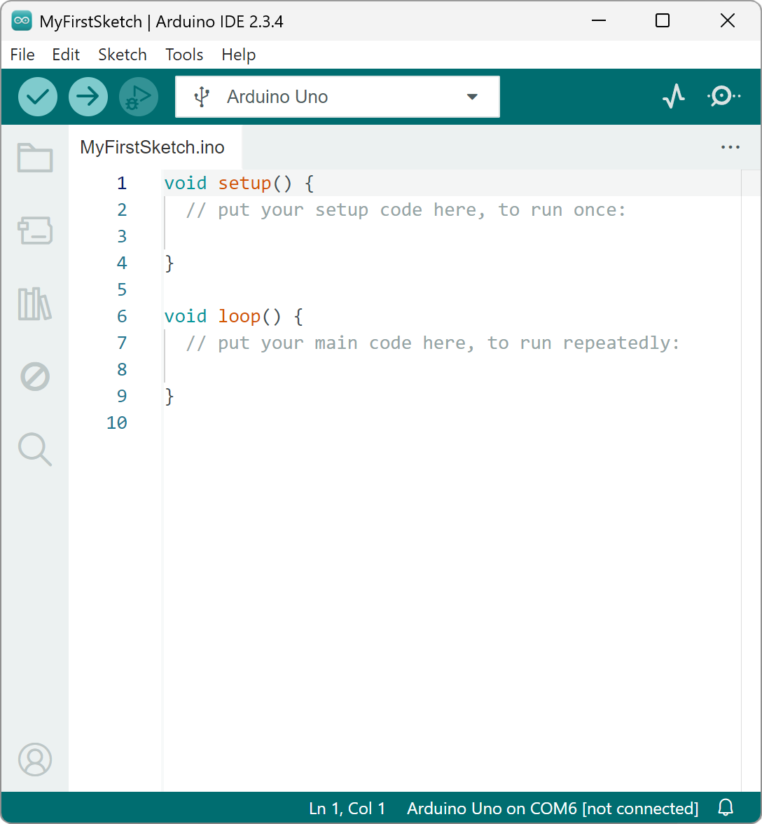
1.4 Software — Arduino IDE
writing, compiling, and uploading code
use C++
download link:
Arduino’s web page
https://www.arduino.cc/en/software/#ide

Slide 30
1.4 Software — Arduino IDE

Slide 31
1.4 Software — Arduino IDE
Select Board & Port

Slide 32
1.4 Software — Arduino IDE
Verify & Upload
Select Board & Port

Slide 33
1.4 Software — Arduino IDE
Verify & Upload
Serial Plotter & Monitor
Select Board & Port

Slide 34
1.4 Software — Arduino IDE
Verify & Upload
Serial Plotter & Monitor
Sketchbook
Select Board & Port

Slide 35
1.4 Software — Arduino IDE
Verify & Upload
Serial Plotter & Monitor
Sketchbook
Select Board & Port
Board Manager

Slide 36
1.4 Software — Arduino IDE
Verify & Upload
Serial Plotter & Monitor
Sketchbook
Select Board & Port
Board Manager
Library Manager

Slide 37
1.4 Software — Arduino IDE
Verify & Upload
Serial Plotter & Monitor
Sketchbook
Select Board & Port
Board Manager
Library Manager
Debugger

Slide 38
1.4 Software — Arduino IDE
Verify & Upload
Serial Plotter & Monitor
Sketchbook
Select Board & Port
Board Manager
Library Manager
Debugger
Search

Slide 39
Contents
1. Introduction
1.1 What is Arduino
1.2 Embedded system
1.3 Hardware — Arduino board components
1.4 Software — Arduino IDE
1.5 Summary

Slide 40
1.5 Summary
Arduino is an embedded open-source platform
hardware: Arduino Boards
software: Arduino IDE
basic structure
setup()
loop()

Slide 41
K-12 Microelectronic Workshop Arduino Programming
1 Serial.println(“Thank you!”);

